Slide 1
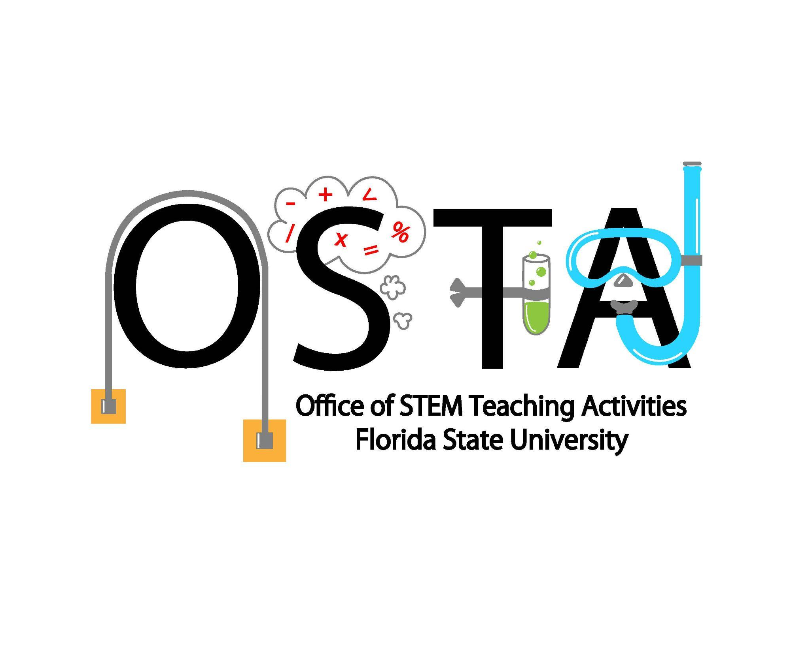
See it Through My Eyes: The comparison of teacher and student perspective
on productive science talk and “doing science” in the classroom.
Fatima Verona, Cristina Murdock, Alexander Blanco, Coralie Lans, Sierra Morandi, & Jennifer Schellinger
Abstract
Research Question
Connecting Perspectives
The purpose of the Learning through Collaborative Design Professional Development (LCDPD) project is to support science teachers in meeting reform visions for science education (NGSS, 2013; NRC, 2012). One aspect of this vision is to engage students in productive science talk, talk that positions students to sensemake about scientific phenomenon and develop understandings of scientific concepts and practices. This study takes a deeper look into Mr. Jerry’s middle school biology class to better understand how Mr. Jerry and his students interpreted four focal lessons designed to engage them in productive talk. Through thematic coding, the first four authors identified aspects of students’ interpretations and feelings around these lessons and compared them with Mr. Jerry’s perspective of the same lessons. Through this analysis, we found Mr. Jerry and his students to have similar accounts of the importance of talk in the classroom, and that one lesson, the skin cancer lesson, was particularly impactful on students’ ideas about how science is done. Additionally, we found that Mr. Jerry and his students differed on how they saw the teacher role in talk, as Mr. Jerry saw himself as a facilitator and his students saw him in an authoritative “knowledge giver” role. These initial findings suggest the need for research to look deeper at the framing of the lesson and the role students’ perception plays in the larger ideas of “doing science” when engaging in talk.
What are the perceptions of one middle school science teacher and his students related to four focal lessons designed around productive science talk?
Similarities
Across the lessons, Mr. Jerry was satisfied with the class discussion. Many times he described the activity the students were engaging in as being helpful for their learning but he especially highlighted the students’ interest and engagement in the skin cancer lesson, as he noticed that students who previously barely participate engaged a lot more. This was a similar perspective to what his students spoke about in their interviews. Many students wanted to recount not only the “fun” of the lesson but how they felt as though they were engaging in the “doing of science”. We coded these instances as similarities across Mr. Jerry and his students.
In regards to talk, Mr. Jerry noted that students were building off of each other’s ideas from talking and arguing from evidence. He described talk to be the communication of ideas from different students after they had been given a topic. Many students had mentioned how talk was important for discussions and it had a role in helping them to see different ways of thinking that they might not have to come to on their own. They also noted that it allows them to “build explanations.”
Difference
Mr. Jerry explicitly saw his role in talk as the facilitator and to question students to push their thinking forward. In the small group, he was there to press students when needed. Students had identified that the small group was where friends (peers) could help to make sense of the questions but ultimately Mr. Jerry would guide students to the direction they needed to go in, sometimes through his questioning. They consistently discussed how Mr. Jerry is the questioner who “knows the right answer” and is “trying to get us there”. In the whole-class discussions, Mr. Jerry saw himself as the orchestrator of their ideas. However, this differed greatly from students who said that the teacher-student discussions happened so they [the students] could learn what was the accepted idea and how another idea might be wrong.
Results
Theme |  | Mr. Jerry’s Perspective | Students’ Perspective
What was the teacher’s role in talk? | Whole Group | “I’m using the ideas that are shared to just keep building the conversation.” | Student 15: “Teacher to student discussions are very important because if a student doesn't grasp a concept, you can directly ask the teacher.” “[Mr. Jerry] asked a question and then we type the answers into chat… He just wants to make sure that we can try to understand the concept. And even if people are wrong, he'll still elaborate on why a thing is such.” Student 4: “It's a discussion with a teacher or teachers letting us know, like, what's correct. What's wrong. [Even] if it's not wrong, what's the accepted idea. And it just clears things up more.”
 | Small Group | “[in the small groups] I’m there to monitor and ask questions. But I’m not there to tell them anything.” | Student 15: “Sometimes your friends need to help you on certain topics.” Student 22: “[In small group] especially when we have questions, we bring them up to Mr. Jerry and then [he] will tell us what he thinks and he would give us like hints or like he would tell us if we're going the right direction, wrong direction.” Student 21: “Mr. Jerry typically likes to split us into different groups and, let us figure out things on our own and then come back and then he'll tell us, like, do this.” Student 6: “Usually Mr. Jerry likes to throw in like five extra questions. And [so] then you have to explain through that. Mr. Jerry. He already knows the answers. So he's just asking you to get you to think about it.”
Talk in the Classroom |  | “[its] multiple students all sharing ideas and critiquing ideas” “They [students] need to be talking about something that will make them talk.” | Student 7: “Discussions play the role of helping to better understand the concept through different opinions and also sort of learning from our people's opinions, learning to accept it and mix them together occasionally.” Student 14: “If I were to do [figuring it out] by myself, maybe I would only see it from, as I said before, one angle. So I, maybe I could be able to find an answer, but there might be a better answer from a different angle, which I had, which I wouldn't have been able to see.” Student 12: “[Talk] plays a role of like building upon what's already been learned like, to give better explanation.”
Skin Cancer Lesson |  | “It was so great…I think giving them local data was a game changer. It was relevant to humans.” “They [students] were question each other’s ideas…even some of my barely participating students wanted to engage in the activity.” | Student 17: “With a skin cancer one, they gave us like a website where we could actually have like viable, uh, data with numbers. And it was more fun doing that when I think I had a greater amount of enjoyment.” “It was, it was, it was like easier, like easier to formulate a response. Like it could be different, not easier from the response, but gathering up the evidence and making a claim and like elaborating with others” Student 7: “[I was doing since] in the stage between the searching for information, um, inside the recommended sources and applying that information into a claim.”
Introduction
Current science education reforms focus on the conceptualization of science classrooms as spaces where students develop explanations and conceptually and epistemological understandings of science (NGSS Lead States, 2013; National Research Council, 2012). The Learning through Collaborative Design Professional Development project, funded by the National Science Foundation, is a joint research effort between Florida State University and Georgia State University that focuses on supporting science teachers’ instruction that enhances student thinking through productive talk. Productive talk positions the teacher as the primary facilitator in the classroom and allows them to utilize strategies to invoke student ideas and foster discussion (Michaels & O’Connor, 2015). Engaging students in productive science talk can seem foreign or challenging for many teachers. However, the practices that support talk can be learned and refined. The classroom strategies emphasized in the professional development are aligned with 30 years of classroom-based research aligned with the ambitious types of instruction of the science education reform movement (Windschitl et al., 2018). To meet the goals of the reform vision, we have to move past just introducing a new curriculum to teachers and ask them to modify that curriculum but, instead, introduce and engage teachers in approaches that promote teachers’ learning about and the enactment of productive science talk.
The purpose of this study is to examine the different perspectives of one teacher and nine of his students around four focal lessons designed to engage the students in sensemaking through productive talk.
Conclusion
Purpose
The purpose of the Learning through Collaborative Design Professional Development (LCD PD) is to support teachers in facilitating talk in the classroom, allowing students to engage in meaningful sense making about phenomena and form explanations about the natural world. The findings of this study support the idea that the role of the teacher in facilitating productive talk can shape student agency in their engagement in the “doing of science”. With these initial findings, we hope to explore deeper into the student perspective to better support teachers in their promoting of student learning and agency.
Methods
This data for this study comes from a larger NSF funded professional development (PD) project. This PD is in support of teachers in productive science talk. We specifically are looking at Mr. Jerry, a middle school science teacher in his third year of the project, where he engaged in ambitious teaching.
The interview protocol was built to get at students’ overall view of science, better understand aspects of specific lessons which were designed through engagement in the PD, and see the role of talk from the student perspective. These interviews were conducted by graduate students who worked on the project and with the teachers of the PD.
Of the thirteen students that agreed to interview, we selected nine of these interviews to focus on. Four interviews were omitted from coding as they were not easy to obtain or the audio was difficult to understand. We focused on the specific lesson questions written to gain perspective from the students.
All the interviews were transcribed using Temi, an AI transcription service. In addition to the student interviews, we examined and coded Jerry’s pre and post-lesson interviews and his post year interview.
We identified major themes from the student interviews and analyzed them across students. Then, we focused on nine specific questions that drew on students’ ideas of productive talk, its role, and the focal lesson of their choice and explored the connections that Jerry had made in his reflection of his own teaching.
Key References
NGSS Lead States. (2013). Next generation science standards: For states, by states.
Washington, DC: National Academies Press.
National Research Council. (2012). A framework for K-12 science education: Practices,
crosscutting concepts, and core ideas. Committee on a Conceptual Framework for New K-12 Science Education Standards. Board on Science Education, Division of Behavioral and Social Sciences and Education. Washington, DC: The National Academies Press.
Michaels, S., & O’Connor, C. (2015). Conceptualizing talk moves as tools: Professional development approaches for academically productive discussion. In L. B. Resnick, C. S. C. Asterhan, & S. N. Clarke (Eds.), Socializing intelligence through talk and dialogue (pp. 347-362). Washington, DC: American Educational Research Assn.
Michaels, S., & O’Connor, C. (2012). Talk science primer. Cambridge, MA: TERC.
Windschitl, M., Thompson, J., & Braaten, M. (2020). Ambitious science teaching. Harvard Education Press.
This material is based upon work supported by the National Science Foundation under DRL #1720587. Any opinions, findings, and conclusions or recommendations expressed in this material are those of the authors and do not necessarily reflect the views of the National Science Foundation.

